Slide 1


VIRTUAL INTELLIGENCE SERVICE
VICTORIA PER INTELLECTUM
TITLE
INTSUM VIS-AIR-01
DISCLAIMER:
This is for multiplayer online gaming using the Digital Combat Systems simulation software published by Eagle Dynamics. The information is not in any way suitable for real world use or operations.
Version: 1.1
Published: 2020-09-17

Slide 2
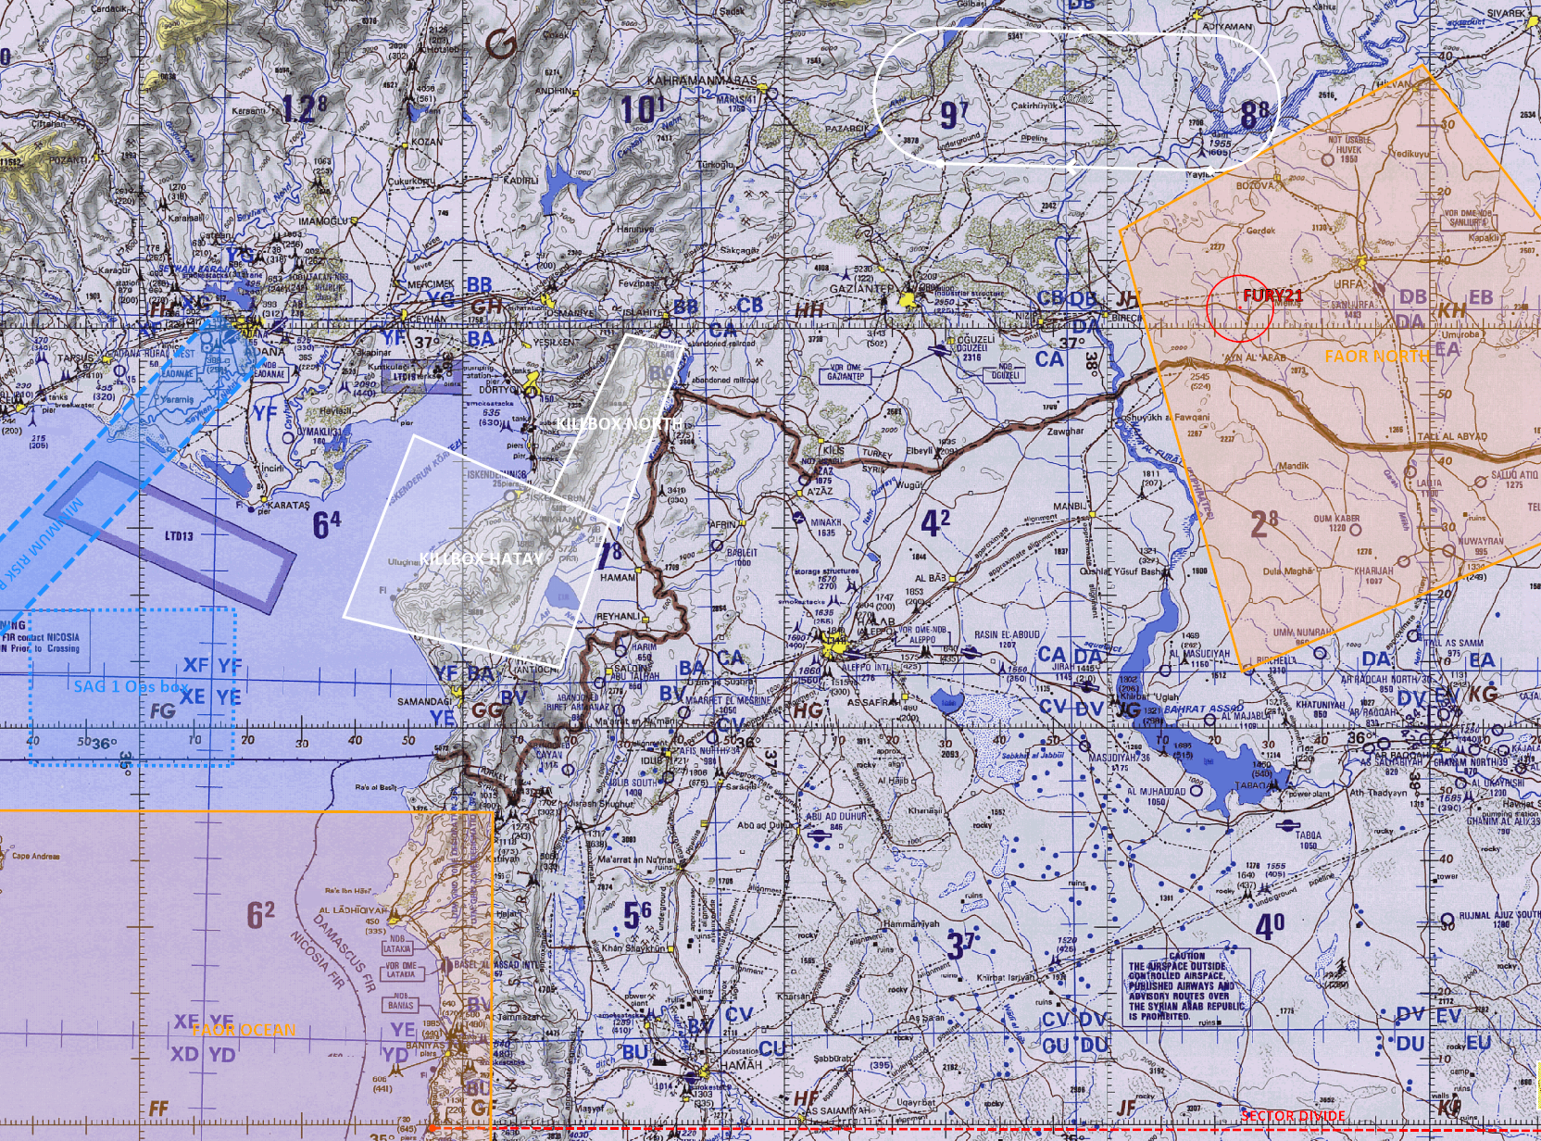
MAJOR EVENTS LAST PERIOD
FAOR NORTH:
FURY2 engaged 1x MiG29 (CONFIRMED KILL)
FURY22 reported EJECTED at BULLS 038/170 - IVO N37 02.883 E038 24.897
INSERT MAP HERE
A
B
B
C
C
D
D
E
E
F
F

Slide 3
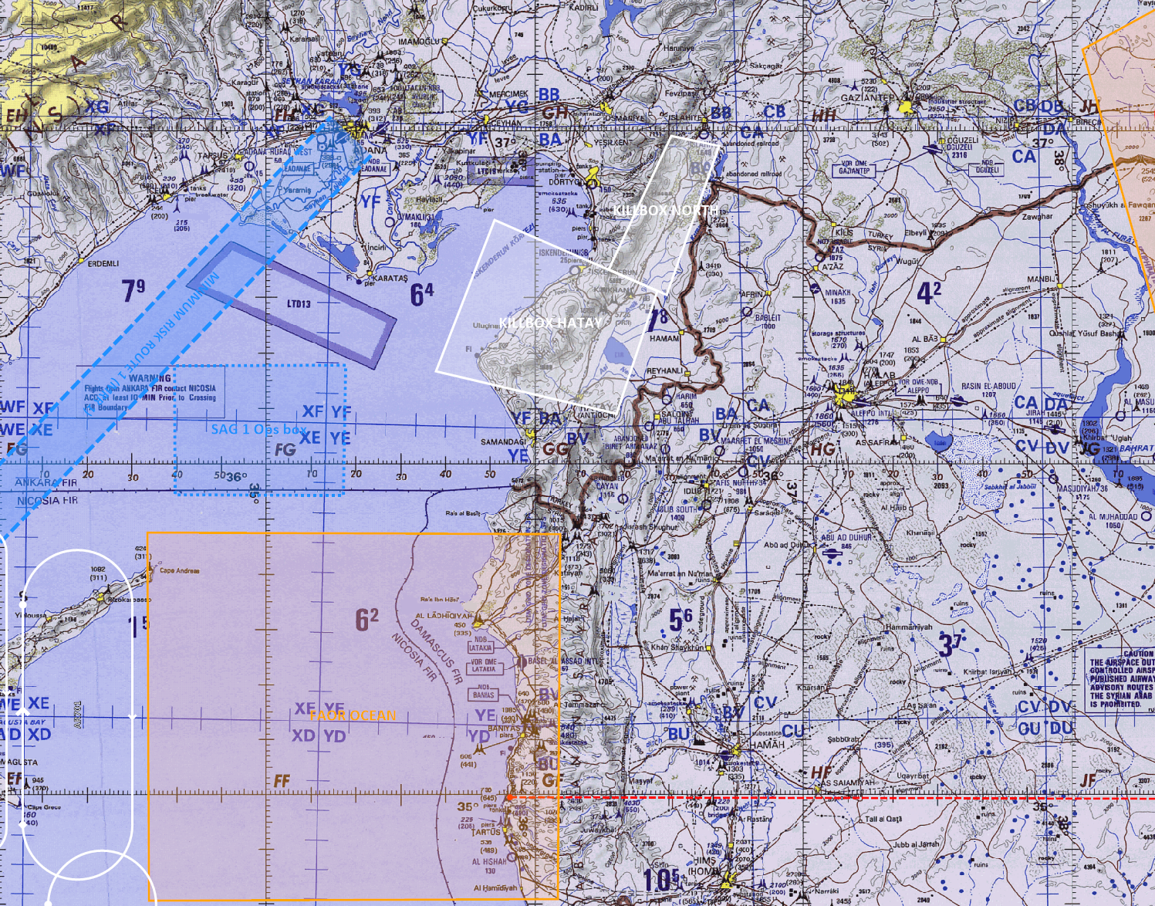
MAJOR EVENTS LAST PERIOD
FAOR OCEAN:
SPECTRE9 engaged 2x MiG29 (CONFIRMED KILLS)
SPECTRE9 engaged 2x Su24 (CONFIRMED KILLS)
INSERT MAP HERE
A
A
B
B
C
C
D
D
E
E
F
F

Slide 4
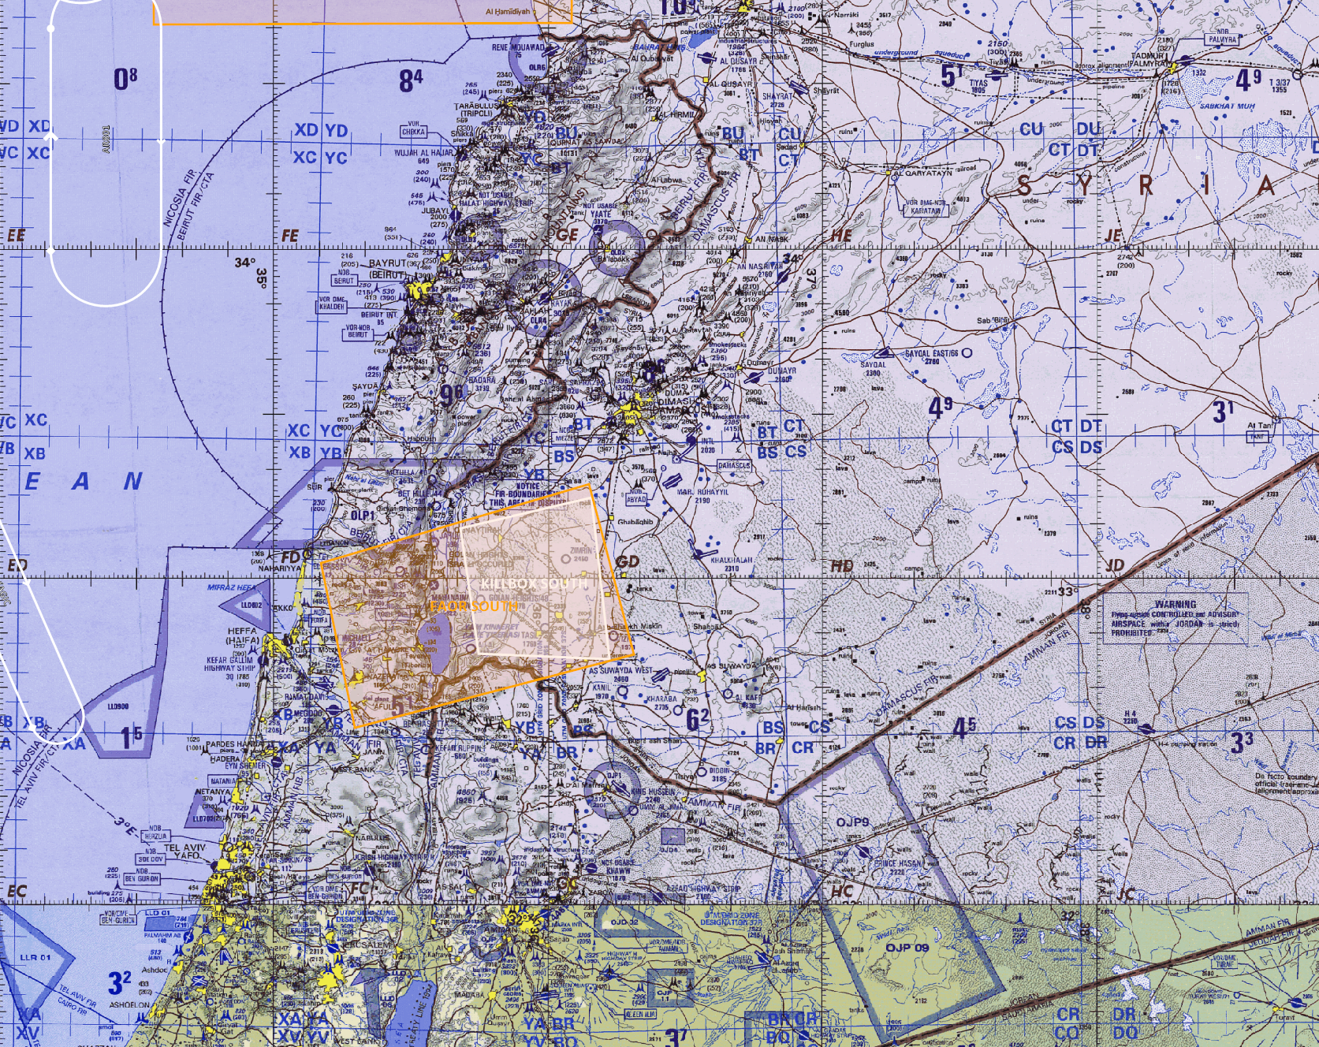
MAJOR EVENTS LAST PERIOD
FAOR SOUTH:
RAGE3 engaged 1x BANDIT (ESCAPED SOUTH)
RAGE3 engaged 1x MiG21 (CONFIRMED KILL)
RAGE3 engaged 1x BANDIT* (CONFIRMED KILL)
RAGE3 engaged 2x MiG29 (CONFIRMED KILLS)
RAGE3 escorted 1x Tu95**
* Second BANDIT believed to be additional MiG21
** Tu95 intercepted 80 NM west of RAMAT DAVID. No hostile intent shown and was escorted back WEST. Reported to have Russian markings
INSERT MAP HERE
A
B
B
C
C
D
D
E
E
F
F
A

Slide 5
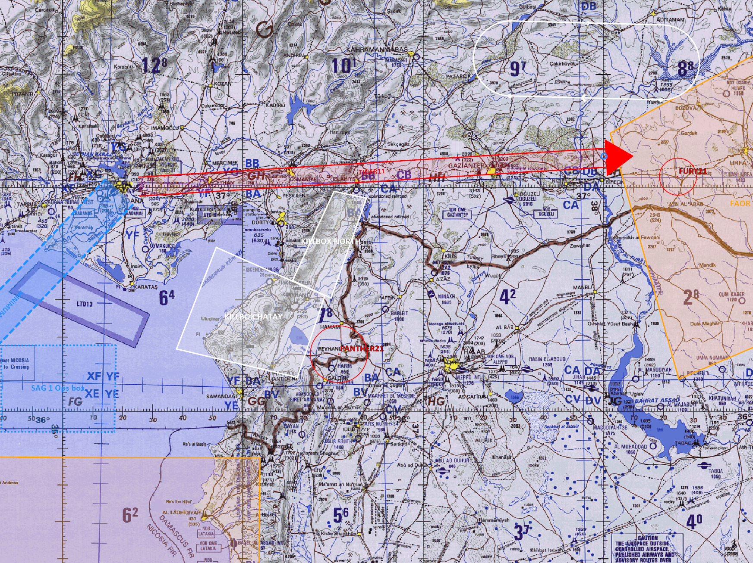
MAJOR EVENTS LAST PERIOD
OTHER:
PANTHER12 reported shot down with no chute BULLS 014/80 – IVO N36 15.399 E036 32.097
TIGER1 missing EAST of FAOR NORTH. Last indicating moving towards FURY22 on bearing 080 from INCIRLIK.
INSERT MAP HERE
A
A
B
C
C
B
D
D
E
E
F
F
A

Slide 6
BDA LAST PERIOD
CONFIRMED:
5x MiG29
1x MiG21
2x SU24
UNCONFIRMED:
1x UNKNOWN – Possibly MiG21
INSERT MAP HERE
A
A
B
B
C
C
D
D
E
E
F
F

Slide 7
SUMMARY OF ENEMY SITUATION (facts)
SyAAF shows willingness and ability to commit own air assets to defend own airspace
SyAAF shows willingness and ability to commit own air assets to attack CJTF forces – both inside and outside own airspace
INSERT MAP HERE
A
A
B
B
C
C
D
D
E
E
F
F

Slide 8
ASSESSMENT OF ENEMY SITUATION (Short term)
Expecting SyAAF to mobilize and commit further air assets to defend against - or attack – CJTF air assets
Expecting SyAAF to continue to exploit shortcomings in CJTF radar coverage inland
Expecting higher over-all readiness of SyAAF forces, with increased amounts of patrolling flights (CAP) around strategically important assets and areas
INSERT MAP HERE
A
A
B
B
C
C
D
D
E
E
F
F

Slide 9
ASSESSMENT OF ENEMY SITUATION (long term)
SyAAF is currently unhindered from utilizing their full range of airfields and other assets/infrastructure supporting air operations. The attrition rate is low and their overall ability to defend and attack is not impacted significantly this far in the campaign despite some losses on day one.
The assessment is therefore that the SyAAF will be fully able to sustain the current level in the long-term.
JIRAH AB hosting what is believed to be full two squadrons of MiG29s lies relatively close to the CJTF forces and should be able to provide QRF air assets to the northern sector of Syria as well as provide a well-defended staging point for air attacks outside Syrian territory.
INSERT MAP HERE
A
A
B
B
C
C
D
D
E
E
F
F

Slide 10
INTELLIGENCE GAPS
Location of Russian Tu95 assets – Inside Syria?
Possible relocation of enemy assets in support of defensive operations
INSERT MAP HERE
A
A
B
B
C
C
D
D
E
E
F
F

